Slide 1
CALIFORNIA STATE UNIVERSITY, NORTHRIDGE
The Impact of Economic Indicators on National Income
A graduate project submitted in partial fulfillment of the requirements
For the degree of Master of Science in Business Analytics
By
Ida Karimi
May 2025
Notes:
This study is about impact of economic indicators on national income.

Slide 2
Research Objectives:
Conduct descriptive analytics to examine GDP, GDP growth, foreign investment, inflation rate, and government spending.
Develop predictive analytics models using advanced machine learning methodologies to forecast high-income country classification based on the identified indicators.
Evaluate and compare the effectiveness of machine learning algorithms.
Research Question: Do GDP, GDP growth, foreign investment, inflation rate, and government spending significantly influence national income levels, enabling the application of machine learning techniques to accurately classify countries as high-income based on these indicators?
Notes:
Do GDP, GDP growth, foreign investment, inflation rate, and government spending significantly influence national income levels, enabling the application of machine learning techniques to accurately classify high-income countries?
In this study, descriptive analytics were applied to analyze the economic indicators, and predictive analytics models were developed and evaluated to address the research question.

Slide 3

Data Collection Process
Data sourced from the World Data Bank.
Includes information covering the years 2021 to 2023.
The World Bank is dedicated to maintaining data quality, as detailed in their framework for evaluating national statistical systems and enhancing data sharing.
Notes:
Data was sourced from the World Data Bank. The data collection process included: retrieval of all fields related to the five economic indicators for years 2021 to 2023, development of an Entity-Relationship Diagram which guided the creation of a small database to store the necessary data, and execution of queries to extract relevant data points from the database.
Fields with 25% or more missing values were removed to maintain data integrity and fields with fewer missing values were handled using K-Nearest Neighbors imputation techniques. To optimize the dataset for machine learning algorithms, outliers were removed and standardization was performed using the StandardScaler.

Slide 4
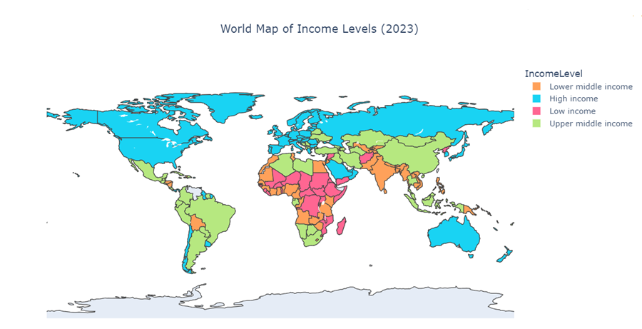
Notes:
According to the World Bank, for the 2025 fiscal year: High-income economies are defined as those with a Gross National Income per capita of $14,005 or more in 2023.
In this map high-income countries are marked in blue and are predominantly located in regions like North America, Western Europe, Australia, and parts of East Asia.

Slide 5
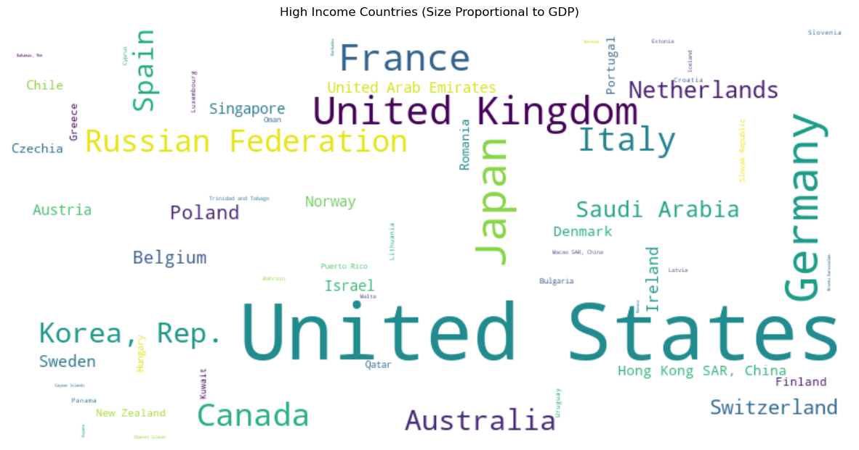
Notes:
To investigate the five indicators—GDP, GDP growth, foreign investment, inflation rate, and government spending—and examine their influence on economic performance and national income levels, we started by examining how Gross Domestic Product changed from 2021 to 2023.

Slide 6
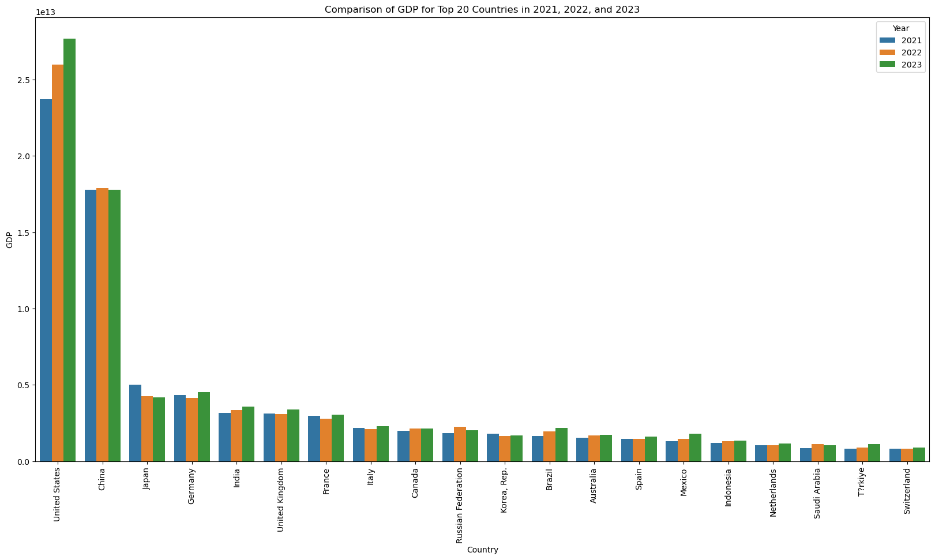
Notes:
Among the top 20 countries with the highest GDP, the United States dominates, maintaining the highest GDP across all three years. China consistently follows in second place.
A statistical analysis was performed to evaluate the difference in GDP between high-income countries and countries in other income groups. The results of the t-test yielded a T-statistic of 2.46 and a P-value of 0.01, indicating a significant difference at the 95% confidence level.

Slide 7
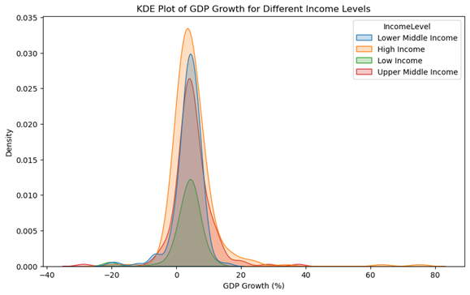
Notes:
This Kernel Density Estimate plot illustrates the distribution of GDP growth rates across four income levels. In the High Income Group, the distribution is more concentrated, with a peak near the moderate GDP growth rate range which indicates that most high-income countries have stable and predictable GDP growth rates.

Slide 8
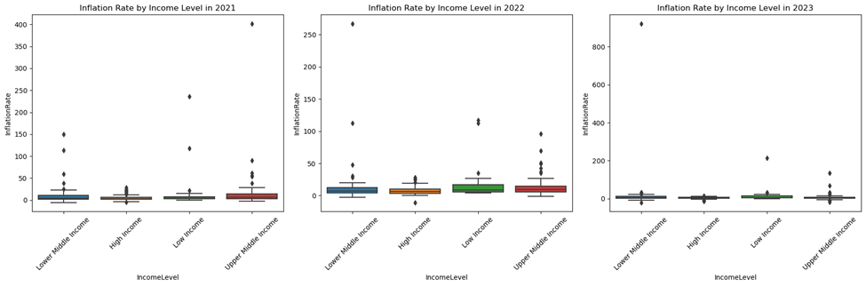
Inflation Rate
A chi-square test was conducted to determine if income level impacts inflation rate.
Chi-square statistic: 13.5686
P-value: 0.0036
Notes:
During this period, right after the COVID pandemic, inflation affected all income groups, but its impact was much greater on lower-income nations.
A chi-square test was conducted to determine if income level impacts inflation rate. The P-value of 0.0036 indicates a significant relationship between income level and inflation rate.

Slide 9
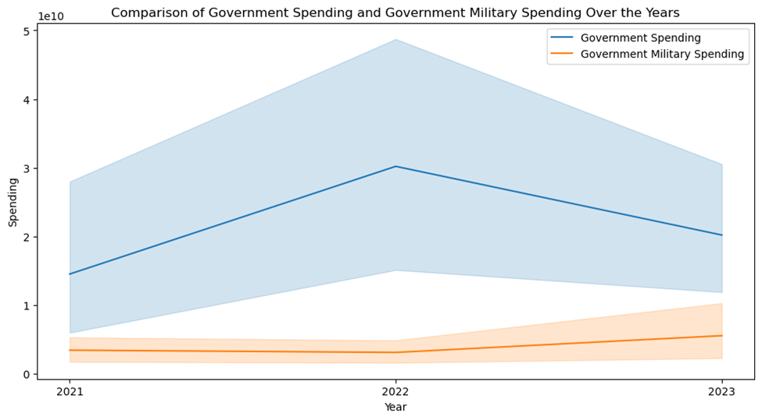
Notes:
After the covid pandemic, government spending was one of the key economic indicators that shaped recovery trends, inflation control, and overall financial stability and a significant component of government spending is military spending, which plays a crucial role in national security and global influence but also impacts broader economic conditions.
Government spending increased sharply in 2022, peaking during economic recovery efforts. However, military spending showed a steady or modest upward trend, indicating continued defense priorities despite shifts in overall policies.

Slide 10
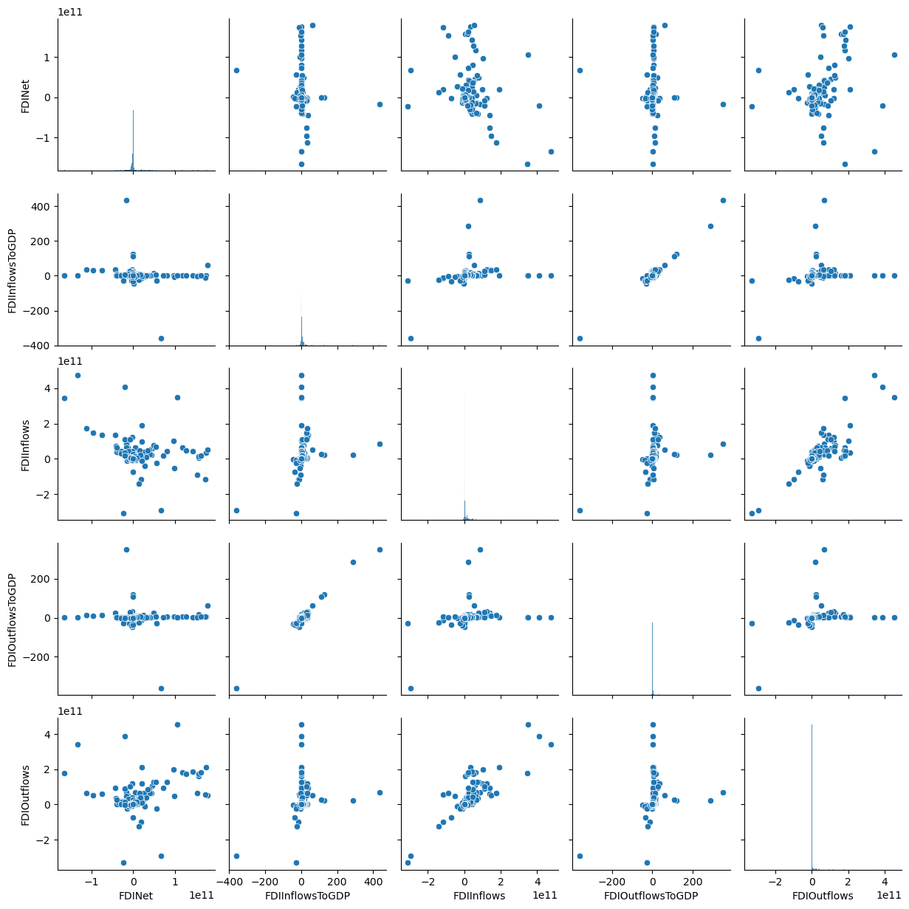
Foreign Direct Investment
Notes:
Another crucial economic indicator to consider is foreign investment, which plays a significant role in driving economic growth, trade opportunities, and financial stability. Foreign investment can bring in capital, technology, and expertise, helping countries strengthen industries, create jobs, and enhance productivity.
These graphs indicate varying degrees of correlation among foreign direct investment indicators. Countries with higher FDI inflows generally show proportionate FDI outflows, reflecting the interconnected nature of global investment flows.

Slide 11
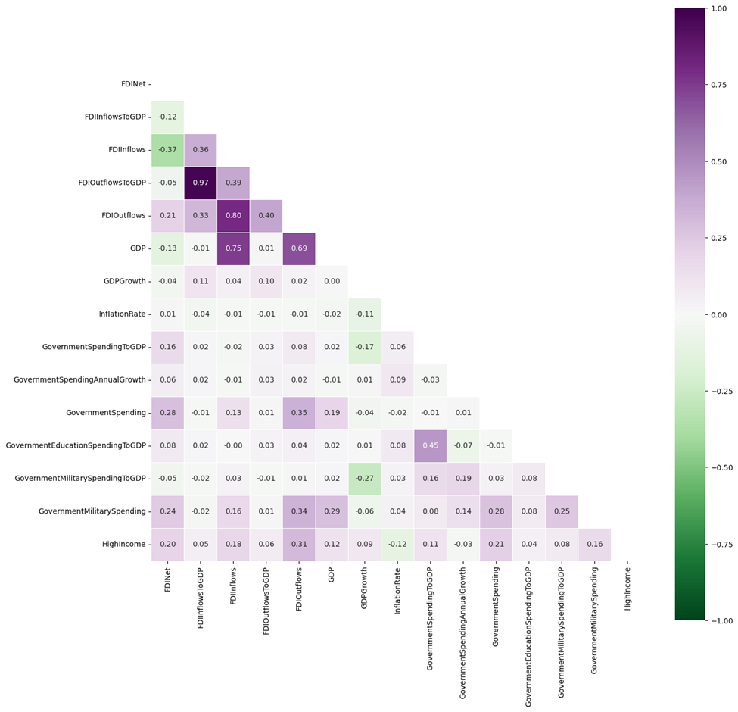
Correlation Heatmap
Notes:
This heatmap visualizes the pairwise correlations between all numeric variables used in this study.

Slide 12
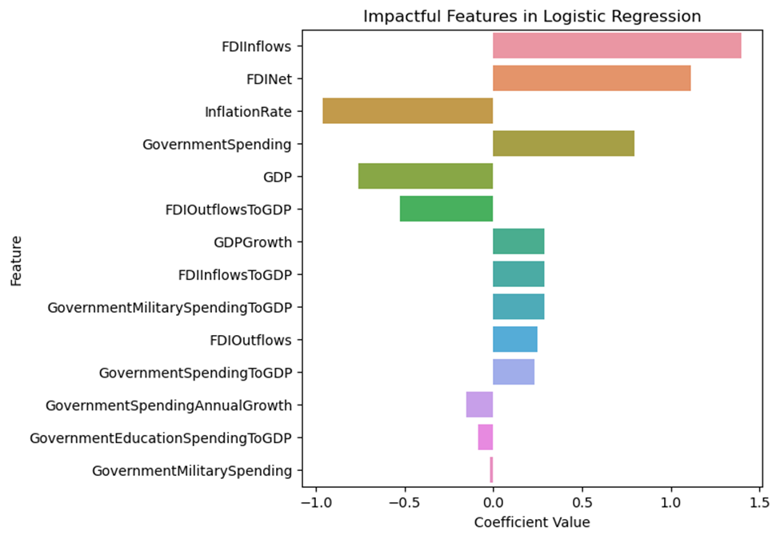
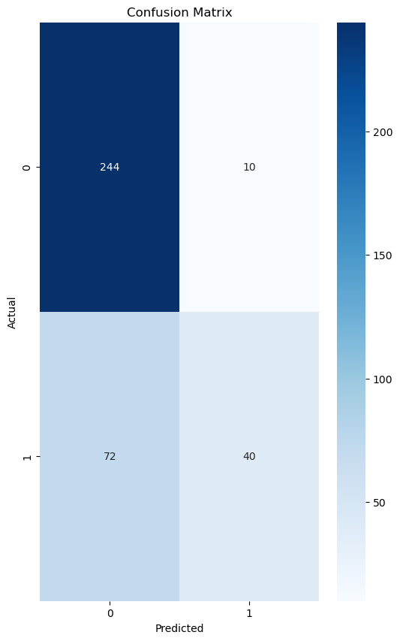
Logistic Regression
(Accuracy: 0.78)
Notes:
A logistic regression model was developed using k-fold cross-validation to assess whether economic indicators can predict high-income countries. The model was tested across multiple folds, producing cross-validation accuracy scores with an average accuracy of 0.78. The accuracy values remain relatively stable across different training and validation sets, indicating that the model generalizes well to new data. The model correctly predicted 244 instances as non-high-income countries (true negatives) and 40 instances as high-income countries (true positives). There were 72 false negatives, meaning some high-income countries were misclassified as lower-income, and 10 false positives, where the model mistakenly classified lower-income countries as high-income.
Features such as FDI inflows, FDI net, and government spending have positive coefficients, suggesting that higher values of these indicators make a country more likely to be classified as high-income.

Slide 13
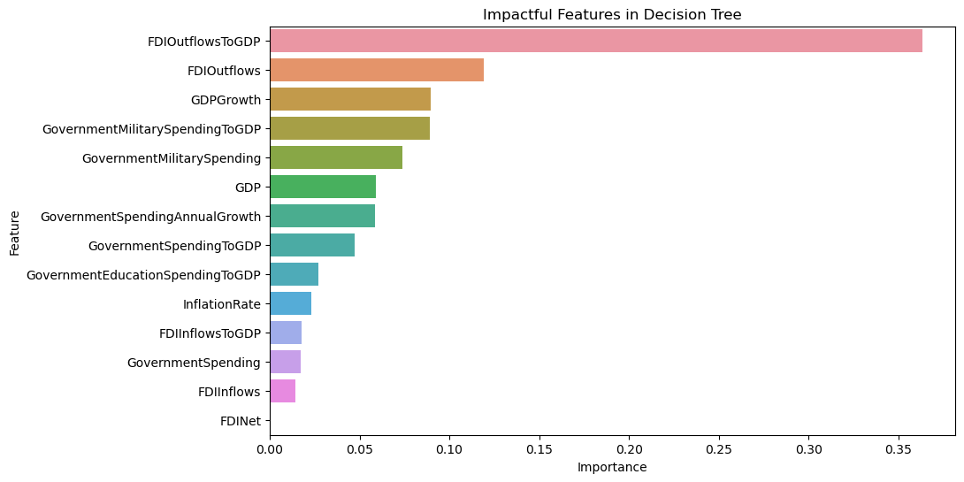
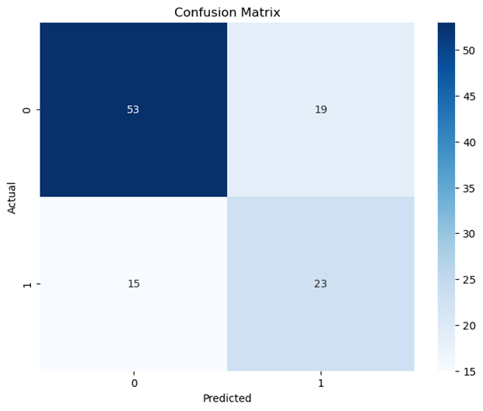
Decision Tree
(Accuracy: 0.69)
Notes:
A decision tree model was developed for the same investigation. The model achieved an accuracy of 69%, indicating moderate predictive power. The confusion matrix reveals that the model correctly identified 53 non-high-income countries (true negatives) and 23 high-income countries (true positives). There were 19 false positives and 15 false negatives. The decision tree’s accuracy of 69% is lower than the logistic regression model’s 78% accuracy, suggesting that logistic regression might be more effective for this classification task.
Here FDI Outflows to GDP is the most influential feature.

Slide 14
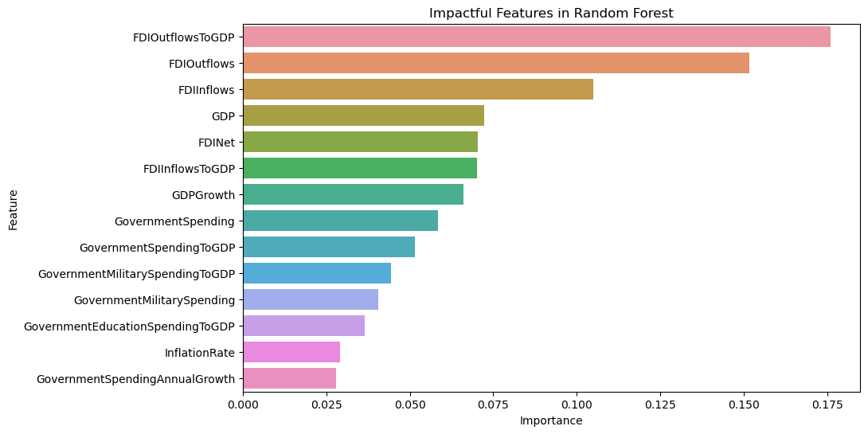
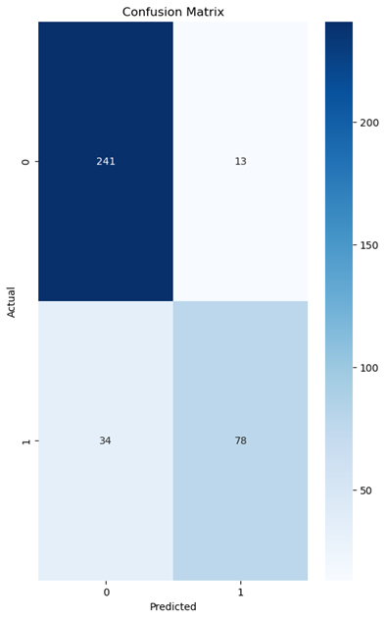
Random Forest
(Accuracy: 0.84)
Notes:
The next model developed for this investigation was a Random Forest classifier. The model maintained strong performance on unseen data, achieving 84% accuracy, an improvement over the previous decision tree model and outperforming logistic regression. The model successfully classified 241 non-high-income countries, correctly identifying them based on economic indicators, and accurately predicted 78 high-income countries, demonstrating strong classification performance. However, there were 13 false positives and 34 false negatives.
The most impactful feature in the Random Forest model is FDI Outflows to GDP, followed by FDI outflow and FDI inflow, emphasizing the importance of Foreign Direct Investment.

Slide 15
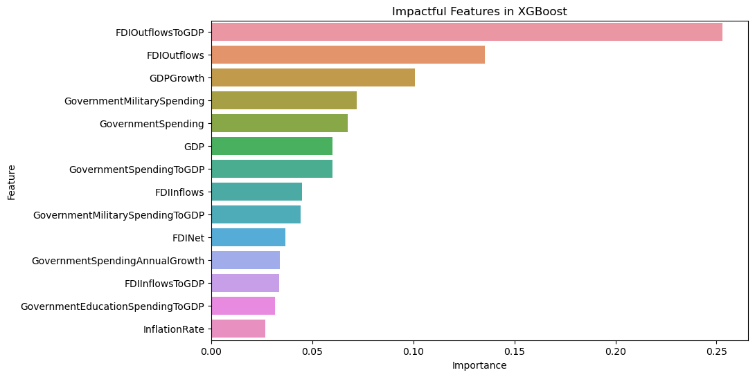
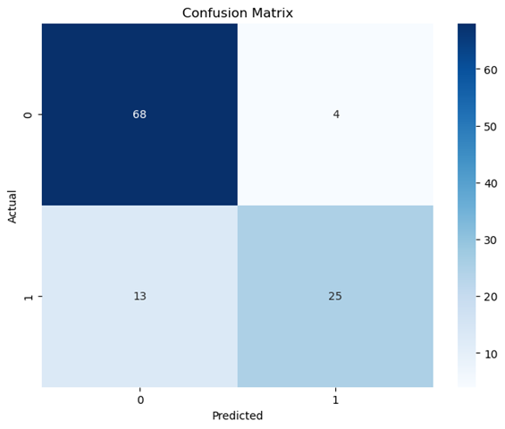
XG Boost
(Accuracy: 0.85)
Notes:
The next model developed for this investigation was XGBoost which achieved a test accuracy of 85%, surpassing previous models and demonstrating strong predictive capability. The XGBoost model correctly classified 68 non-high-income countries (true negatives) and 25 high-income countries (true positives).
Again FDI Outflows to GDP followed by FDI Out flows are the most influential feature, reinforcing the idea that outbound foreign investment strongly correlates with high-income classification.

Slide 16
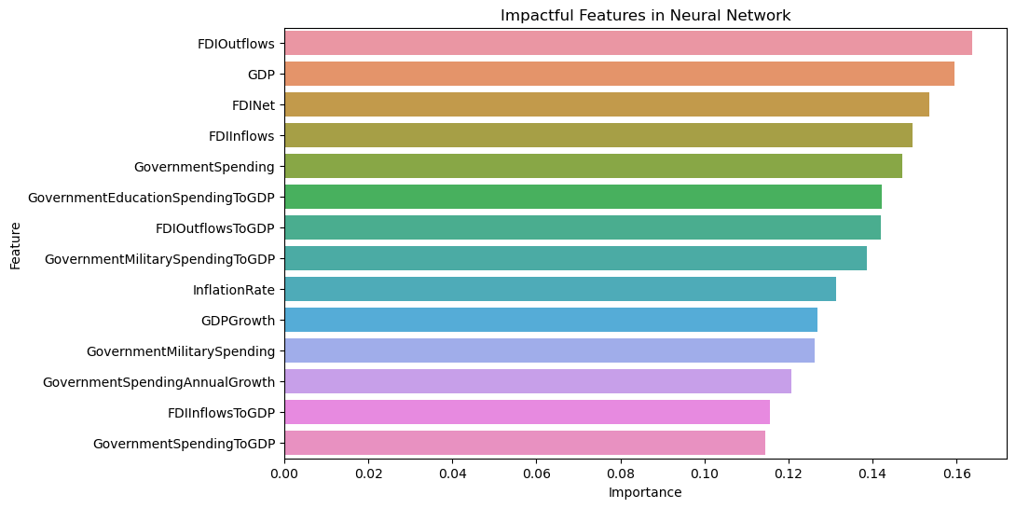
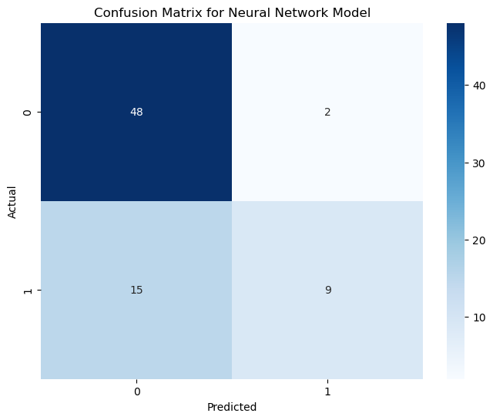
Neural Network
(Accuracy: 0.77)
Notes:
A neural network model was developed to assess whether it could more effectively predict high-income countries based on economic indicators but the model didn't perform as well as the two previous models and only achieved an accuracy of 77%.

Slide 17
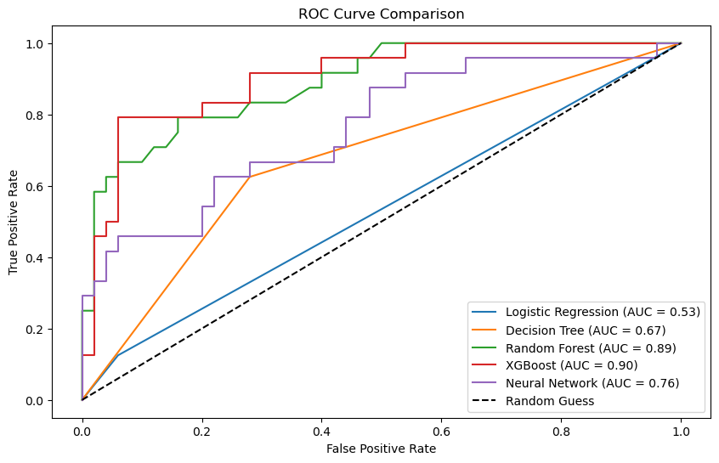
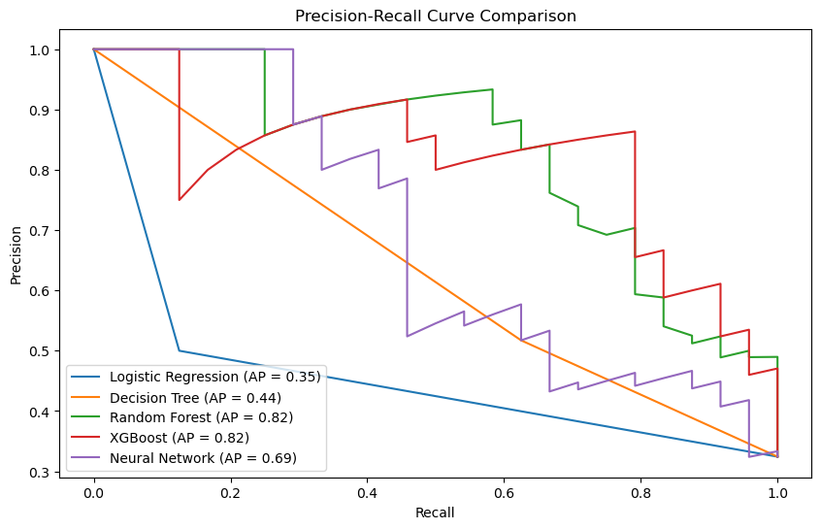
Models Comparison
+---------------------+-------+-------------------+
| Model | AUC | Average Precision |
+---------------------+-------+-------------------+
| Logistic Regression | 0.532 | 0.346 |
| Decision Tree | 0.672 | 0.445 |
| Random Forest | 0.889 | 0.824 |
| XGBoost | 0.903 | 0.817 |
| Neural Network | 0.763 | 0.691 |
+---------------------+-------+-------------------+
Notes:
Receiver Operating Characteristic curve illustrates a classification model’s performance, with True Positive Rate plotted against False Positive Rate. The Random Guess baseline (dashed line) represents an Area Under the Curve of 0.5, meaning models performing near this level aren’t much better than random chance. XGBoost has the highest Area Under this Curve, making it the best-performing model in this comparison.
Precision-Recall Curve illustrates the trade-off between precision (how often positive predictions are correct) and recall (how many actual positives are identified). AP, or Average Precision, summarizes the PR curve by calculating the weighted mean of precisions achieved at each decision point, with recall increase as the weight. Random Forest and XGBoost both demonstrate strong precision and recall, achieving an AP of 0.82. These results demonstrate that machine learning models can effectively predict whether countries fall into the high-income category based on examined key economic indicators.

Slide 18
Economic Indicators and High-Income Status
Field | T-Statistic | P —Value
FDINet | 2.747687 | 0.006950
FDIInflowsToGDP | 0.656566 | 0.512810
FDIInflows | 2.665692 | 0.008692
FDIOutflowsToGDP | 0.801692 | 0.424441
FDIOutflows | 4.411134 | 0.000023
GDP | 2.031783 | 0.043870
GDPGrowth | 1.625836 | 0.105671
InflationRate | -3.223025 | 0.001404
GovernmentSpendingToGDP | 2.179906 | 0.030320
GovernmentSpendingAnnualGrowth | -0.633536 | 0.526816
Governmentspending | 2.829848 | 0.005497
GovernmentEducationSpendingToGDP | 0.838156 | 0.402667
GovernmentMiIitaryspendingT0GDP | 1.702764 | 0.089583
GovernmentMilitarySpending | 2.484512 | 0.014115
Notes:
This table presents the results of t-tests analyzing the relationship between economic indicators and high-income status. The T-Statistic quantifies the strength of the relationship and the P-Value determines statistical significance. A higher absolute t-value (e.g., greater than 2, the green rows, or less than -2, the orange row) suggests stronger evidence against the null hypothesis. The p-value tells the probability of obtaining results at least as extreme as those observed, assuming the null hypothesis is true. The result is typically considered statistically significant when p is less than 0.05, meaning there’s strong evidence to reject the null hypothesis.
This table provides a clear overview of the strong correlation between these economic indicators and the classification of a nation as a high-income country. This relationship underscores the ability of the machine learning models to accurately predict this classification.

Slide 19
Beyond the Data: Addressing Key Research Limitations
Missing values issue: The World Bank database had significant gaps for data from 2021 to 2023, particularly for the last year.
Indicator exclusion: Many fields with more than 25% missing values were excluded, including important economic indicators like government debt.
Dataset reduction: During the data cleaning process, the number of rows was reduced from 651 to 366 due to the high number of missing values, which could have impacted model performance since smaller datasets may hinder predictive accuracy.
Notes:
One of the biggest challenges in this research was presented by the missing values in the World Bank database, especially for the year 2023. Due to this gap, several key economic indicators, such as government debt, had to be excluded, affecting the depth of the analysis. Additionally, fields with more than 25% missing data were removed, further limiting the comprehensiveness of the study. As a result, the dataset was reduced from 651 rows to 366 rows, raising concerns about the predictive accuracy of the models.

Slide 20
Conclusion
• Descriptive analytics were conducted to analyze the economic indicators, including GDP, GDP growth, foreign investment, inflation rate, and government spending.
• Predictive analytics models, such as XGBoost and Random Forest, achieved predictive accuracies of 84.5% and 83.6%, respectively.
• Foreign direct investment emerged as a significant determinant of high-income classification.
• High-income countries demonstrated stable inflation rates and robust investment flows, emphasizing the importance of macroeconomic stability.
• Future research should address the limitations of missing World Bank data (2021–2023) and expand datasets to include granular indicators like employment levels, labor productivity, and sector-specific investment flows.
Notes:
This study successfully demonstrated that key economic indicators—GDP, GDP growth, foreign investment, inflation rate, and government spending—significantly impact national income classification.
Using machine learning methodologies, models such as XGBoost and Random Forest emerged as the most effective, achieving predictive accuracies of 85% and 84%, respectively. The results highlighted the importance of foreign direct investment, particularly FDI outflows, as a critical factor in determining high-income status.
Given the limitations of missing economic data from the World Bank for the years 2021–2023, future research should focus on expanding datasets to enhance predictive accuracy. Including additional years and more detailed economic indicators could improve the strength of classification models.

